Slide 1

Define Quotes Tags Using NLP
Shaikha Bin Ateeq
Raghad Althunayan

Slide 2
Introduction:
Goal:
Quotes have the power to motivate, inspire and encourage At such time, read a few quotes, and you will see how your mood and state of mind begin improve
predict the quote tags whether 'Sadnesses','Knowledge','Universe','Feelings'

Slide 3
- Benjamin Franklin
Tell me and I forget. Teach me and I remember. Involve me and I learn

Slide 4
Dataset
Data Source
Rows & Columns
Features
From Kaggle
Web scraping
(Goodreads)
Rows & Columns (499709,3)
Rows & Columns (83618,3)
Quotes
Author
Category

Slide 5









Tools
Data Cleaning & Manipulation
Model Building
Visualization
NLP

Slide 6
Workflow
Data
Preprocessing
Topic
Modeling
Pick Topic
Modeling
Test
Molding

Slide 7
Data Preprocessing
NLP preprocessing
Pipeline
Another preprocessing
SubSet Of Data
Quotes Where The length of word more than 150
Contraction
Tokenization
Remove Punctuations & Number
Remove Non English world
Remove rare and frequent words
Remove stop world
Lowercase
Remove Repeating Char
Spell Corrections
Stemming
Lemmatization
Remove Word Less Than 3
Remove Verbs
Check Null values
Check duplicate values
Remove Un-wanted Colman
Data After Cleaning (11286, 10)

Slide 8
Topic Modeling
Modeling
Embedding
Latent Semantic Analysis (LSA)
Non-Negative Matrix Factorization (NMF)
Latent Dirichlet Allocation (LDA)
CorEx
CorEx With Anchors
CountVectorizer
Tf-IDF

Slide 9
CorEx Topic
Sadnesses | death,light,earth,dead,blood,beneath,great,fire,soul.
Knowledge | work,book,public,inform,write,read,abus,medium,group
Universe | human,natur,social,societi,individu,moral,modern,polit,scienc
Feelings | head,night,hand,hair,face,breath,mouth,black,look

Slide 10
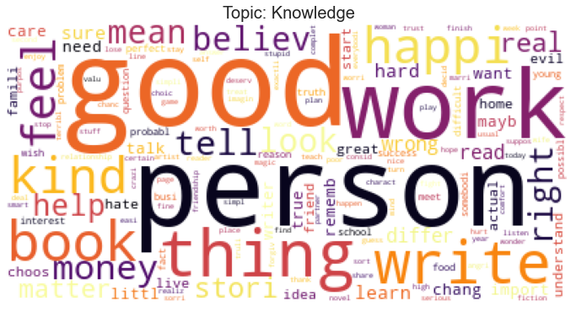
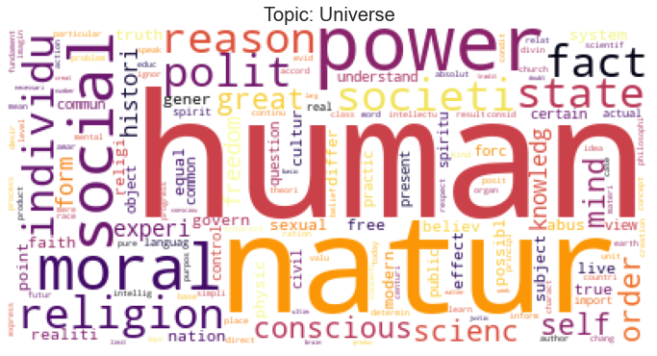
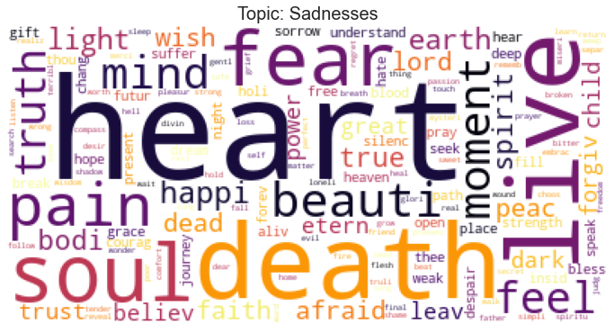
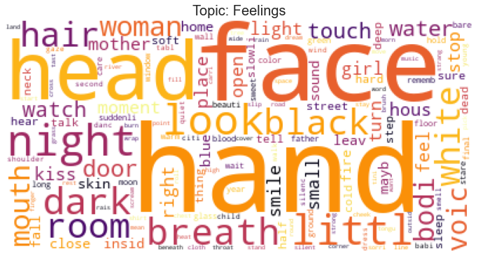
Word clouds

Slide 11
CorEx ”Anchors “ With SemiSupervised
Train
Test
Quotes
Topic
CorEx With Anchors
Topics

Slide 12
Supervised learning
Logistic Regression
Random forest
Classification Accuracy
Logistic Regression
Random forest
Train
0.81
0.82
Val
0.67
0.44
F1-score
0.72
0.46

Slide 13
Challenges And Limitations
Deep Meaning
You were never created to live depressed, defeated, guilty, condemned, ashamed or unworthy. You were created to be victorious
To Be Or Not To Be
Stop Words

Slide 14
Future Work
Feed classifier more features
Model
Deployment

Slide 15
Thanks

